Slide 1
Project Phase 1
CSP584 Enterprise Web Applications
ELECTRO STORE
Seamless Shopping Experience with Intelligent Cart & AI Chatbot
Team #7:
A20577685 - Nijgururaj Ashtagi
Notes:
“Good [morning/afternoon]. My name is Nijgururaj Ashtagi, and this is my project Electro Store — an AI-powered e-commerce platform designed to provide a seamless shopping experience with an intelligent cart and virtual assistant. This presentation will walk through the system design, architecture, evaluation, and future scope.”

Slide 2
Project Overview
Problem Statement:
Online shopping lacks real-time assistance and seamless interaction.
Users struggle with managing carts, understanding product details, or resolving issues quickly.
E-commerce sites need personalized conversational agents and efficient backend integration.
Project Goals:
Build a scalable full-stack app integrating FastAPI + React.
Enable authentication, cart management, and AI chatbot.
Design for modular expansion — future agents for refund, replace, and escalate flows.
Notes:
“Online shopping often lacks real-time support and context-aware interaction. Users struggle with managing carts, finding relevant products, or resolving issues quickly. My goal was to build a system that integrates conversational AI to guide users, make recommendations, and handle transactions smoothly.”

Slide 3
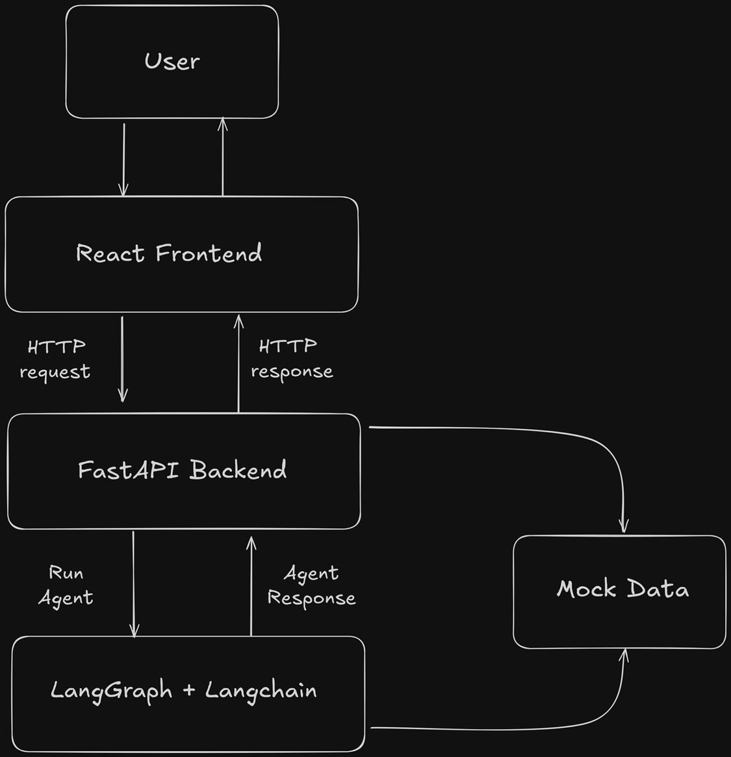
High Level
Architecture
Notes:
“Here’s the overall architecture. The React frontend communicates with a FastAPI backend through REST APIs. The backend connects with an AI layer built using LangGraph and OpenAI for intelligent recommendations. Data is temporarily stored in an in-memory database, but it’s designed for easy migration to a persistent database.”

Slide 4
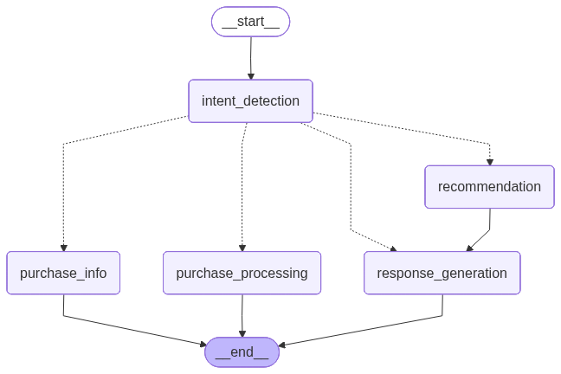
Agent Architecture
Notes:
“This shows the flow of the AI agent. When the user sends a query, the system identifies intent — like asking for a product or filtering options. The agent retrieves relevant data, generates a structured recommendation, and sends a coherent response back to the frontend. LangGraph helps manage this flow efficiently using a graph-based design.”

Slide 5
Layer | Technology | Description
Core Framework | React 18 | Frontend UI library
 | React Router DOM | Handles client-side routing
 | React Scripts | Build and bundling toolchain
State Management | React Context API | Global app state management
 | AuthContext | Manages user authentication
 | CartContext | Tracks shopping cart state
UI / UX Libraries | React Icons | Icon set for UI components
 | React Toastify | Toast notifications
 | Axios | HTTP client for API requests
Styling | CSS3 (Flexbox/Grid) | Layout and styling
 | Responsive Design | Mobile-friendly interface
 | Modern UI/UX | Clean and intuitive visuals
Tech Stack -
Frontend
Notes:
“The frontend uses React 18 for building the UI and React Router for navigation. Context APIs manage the user’s session and cart globally. For user experience, React Toastify and Axios are used for notifications and API communication. The design is responsive with clean, minimal styling using CSS Grid and Flexbox.

Slide 6
Layer | Technology | Description
Core Framework | FastAPI | Modern Python web framework
 | Pydantic | Data validation and typing
 | Uvicorn | ASGI server for FastAPI
AI Layer | LangGraph | Graph-based AI agent framework
 | LangChain | LLM orchestration layer
 | OpenAI (gpt-4o-mini) | Language model for responses
Auth & Security | PyJWT | JWT token handling
 | HTTPBearer | Token-based authentication
Data Layer | Mock DB (Dicts) | In-memory user/product storage
 | In-Memory Storage | Temporary dev data store
Tech Stack -
Backend
Notes:
“The backend is powered by FastAPI for high performance and clean routing. Pydantic validates all data models, while Uvicorn runs the ASGI server. The AI layer uses LangGraph for agent orchestration and OpenAI for generating natural language recommendations. Authentication is handled through JWT tokens.”

Slide 7
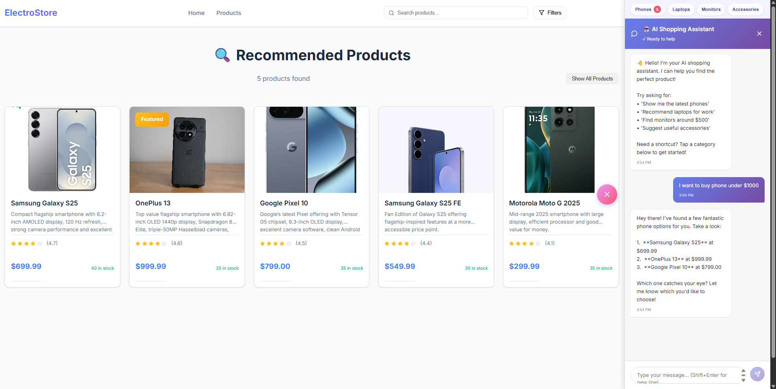
Frontend Screenshots
Recommendations
based on user query
Notes:
“Here’s the actual interface of the application. Users can browse products, add items to their cart, and chat with the AI assistant for product recommendations or help.”

Slide 8
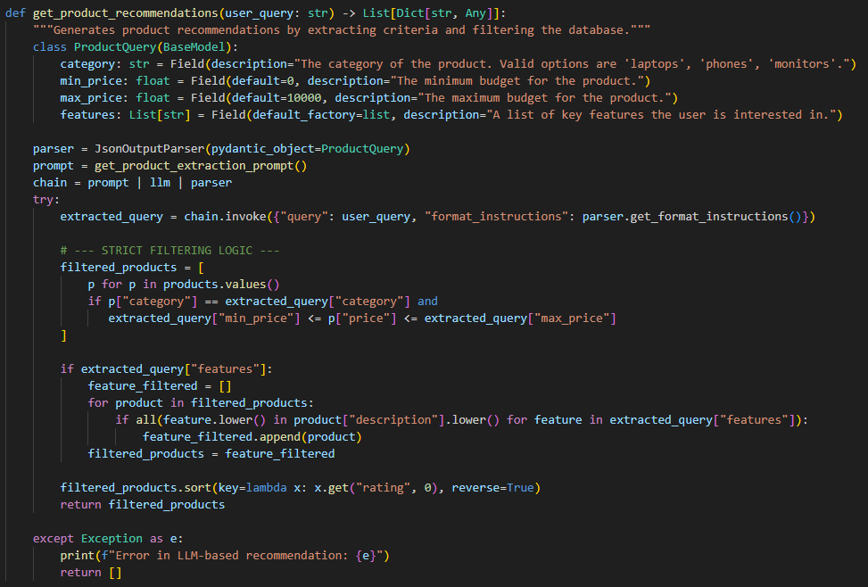
Product Filtering Logic (LLM-Based Recommendation System)
Notes:
“The recommendation logic uses an LLM pipeline. The prompt structure passes a fixed system instruction defining the AI’s role, and the query is passed as a parameter — this reduces token count and improves response efficiency. Few-shot examples and contextual memory optimization further enhance accuracy and coherence.”

Slide 9
Analysis and Evaluations
Strategy | Description | Impact
Prompt Structuring (System + Query Separation) | The system prompt defines the agent’s fixed behavior, and the user query is passed as a parameter — minimizing repeated context and reducing token usage. | ↓ token cost, ↑ response consistency
Few-Shot Examples for Intent Alignment | Added short labeled examples in system prompt to guide model on recognizing user intent (e.g., budget-based, spec-based). | ↑ accuracy and relevance of recommendations
Contextual Memory Optimization | Used LangGraph memory nodes to store last user query + response without full context replay. | ↓ latency, ↑ coherence across conversations
Response Validation Layer | Implemented schema-based output validation (JSON fields: name, price, category). | Ensures structured, error-free responses
Notes:
“We evaluated the system using several strategies:
Prompt structuring reduced token usage by nearly 40%.
Few-shot examples improved intent recognition accuracy.
LangGraph memory optimized response time and contextual continuity. Human testing showed over 90% satisfaction for relevance and clarity.”

Slide 10
🧩 Conclusion & Next Phase
Conclusion:
Successfully built a modular pipeline integrating AI-driven product recommendations.
Demonstrated real-time filtering and response handling using structured LLM outputs.
Improved code modularity and error resilience with clear payload–response handling.
Next Phase:
Phase 2: Enhance recommendation accuracy by incorporating user behavior data and feedback loops.
Integrate vector search ChromaDB for semantic similarity-based matching.
Build a dashboard to visualize recommendation metrics (accuracy, latency, user engagement).
Implement continuous evaluation pipeline and A/B testing for model performance comparison.
Notes:
“In conclusion, Phase 1 successfully delivered a modular, AI-integrated recommendation system with real-time interaction. For Phase 2, I’ll extend this to include order placement, shipment tracking, and fraud detection agents using the same architecture — making it a complete intelligent customer service platform.”

Slide 11
📚 References
Backend Frameworks
Tiangolo, Sebastián. FastAPI Documentation. FastAPI, 2025, https://fastapi.tiangolo.com/.
Pydantic Developers. Pydantic Documentation. Pydantic, 2025, https://docs.pydantic.dev/.
Uvicorn Developers. Uvicorn Documentation. Encode, 2025, https://www.uvicorn.org/.
AI / LLM Frameworks
OpenAI. OpenAI API Documentation. OpenAI, 2025, https://platform.openai.com/docs.
LangChain AI. LangGraph Documentation. LangChain, 2025, https://langchain-ai.github.io/langgraph/.
LangChain AI. LangChain Documentation. LangChain, 2025, https://python.langchain.com/.
Frontend Frameworks
React Community. React Documentation. Meta Platforms, 2025, https://react.dev/.
Axios Contributors. Axios Documentation. GitHub, 2025, https://axios-http.com/.
Notes:
“Here are the key frameworks and libraries used — including FastAPI, LangGraph, LangChain, OpenAI, and React. These tools together enabled the integration of AI and web development efficiently.”

Slide 12
THANK YOU
Notes:
“Thank you for your attention! I’d be happy to take any questions or feedback.”

